Slide 1
19CSE454 - Information Retrieval Case study Title: Simulating CLIR Translation Resource Scarcity using High-resource Languages - Dataset - ICTIR - October 2019

Slide 2
Introduction
Dataset Purpose: Simulates CLIR challenges.
Queries: 200 CLEF queries.
Languages: Translated to Swahili, Somali.
Goal: Study low-resource CLIR.
Availability: Dataset and research accessible.

Slide 3
Objectives
Simulate Cross-Language Information Retrieval (CLIR): Create a simulation that mimics the scarcity of translation resources
Analyse Dataset Characteristics - study the characteristics of the ICTIR dataset, specifically focusing on multilingual document retrieval
Evaluate CLIR System Performance: Measure and compare the performance of the CLIR system
Optimize Cross-lingual Search Efficiency - Aims to improve the efficiency of cross-lingual search by leveraging minimal translation resources while maintaining high retrieval accuracy.

Slide 4
Dataset
query_id: C001
title: Qaabdhismeedka Berlin
description: Hel dokumintiyada qaabdhismeedka Berlin.
…………
query_id: C199
title: Cudurka Ebola ee Zaire
description: Hel wargelinada qiyaasaha ka hortaga la qaaday kadib dilaaca cudurka Ebola ee Zaire.
query_id: C200
title: Fatahaada Holland iyo Jarmalka
description: Hel tirikoobka masiibooyinka fatahaada ee Holland iyo Jarmalka 1995.

Slide 5
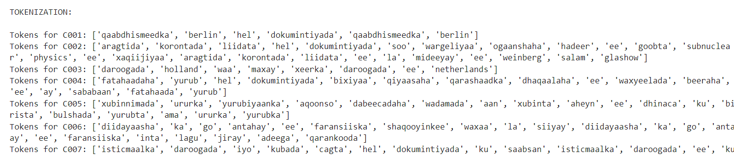
Tokenization
Query Parsing: Reads queries from a file, extracting `query_id`, `title`, and `description`.
Tokenization: Combines title and description, tokenizes the text, and stores all tokens globally.

Slide 6
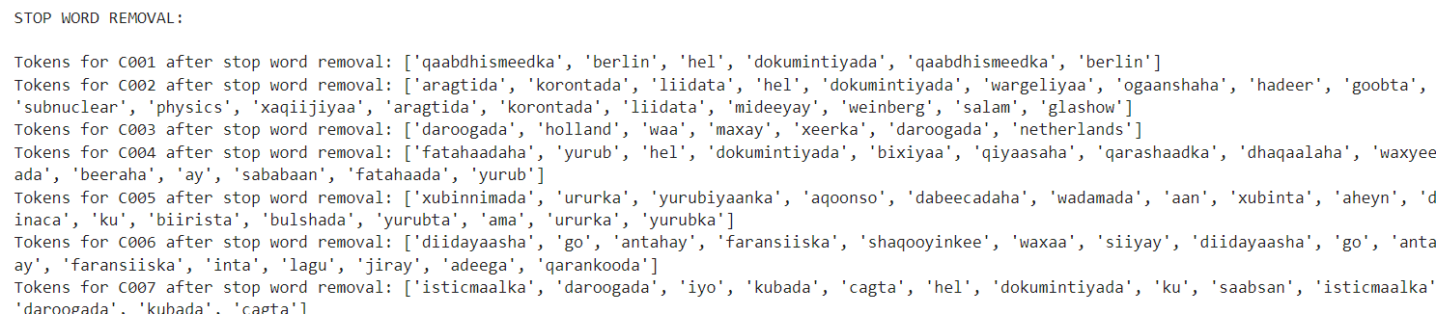
Stop word removal
Filters out specified stop words from the tokens and prints the remaining words for each query.
stop_words = {'ee', 'laa', 'soo', 'ka', 'wa', 'la' }

Slide 7
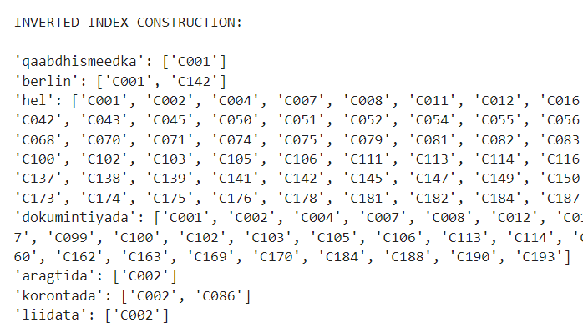
Inverted Index
Builds an inverted index where each unique token is mapped to the query IDs that contain it, and then prints the index.

Slide 8
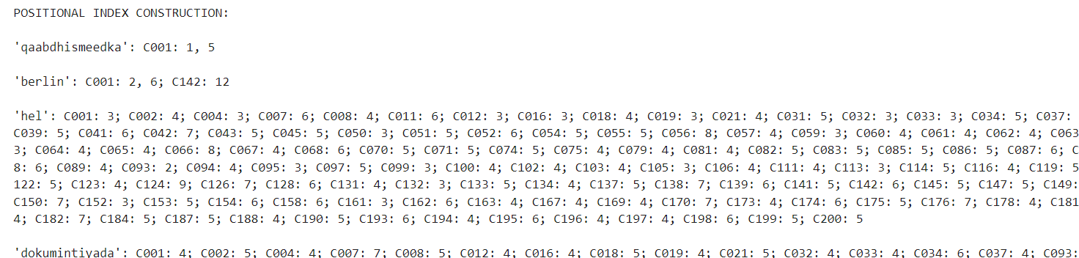
Positional Indexing
Constructs a nested dictionary (inverted index) that maps each token to its corresponding `query_id` and the positions of the token within the text (using a 1-based index) and displays the inverted index, showing each token along with the `query_id`s and their respective positions, facilitating easy retrieval of token occurrences across different queries.

Slide 9
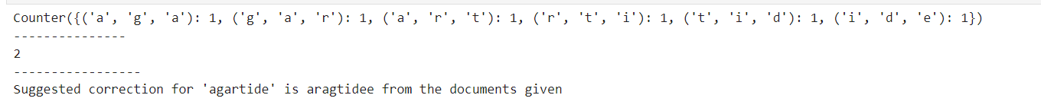
Tri Grams
3-grams (trigrams) to find the most similar word to a misspelled input by comparing its trigrams with trigrams of other tokens. It computes the similarity between two words based on common trigrams and suggests a correction for the misspelled word based on the highest similarity.

Slide 10
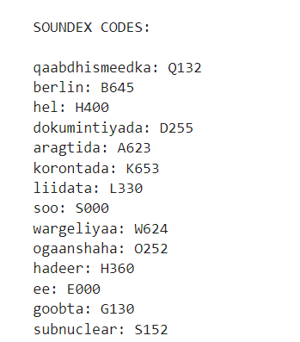
Soundex Algorithm
Implements the Soundex algorithm to convert names into standardized four-character codes based on phonetic similarities, keeping the first letter and replacing subsequent letters using a predefined mapping.

Slide 11
Misspelled word using Edit distance
Calculate the Levenshtein distance between two words, which measures the minimum number of single-character edits needed to transform one word into another, and then finds the closest correct word from a given index (likely a dictionary of words) for a misspelled word by determining which word has the smallest Levenshtein distance.

Slide 12
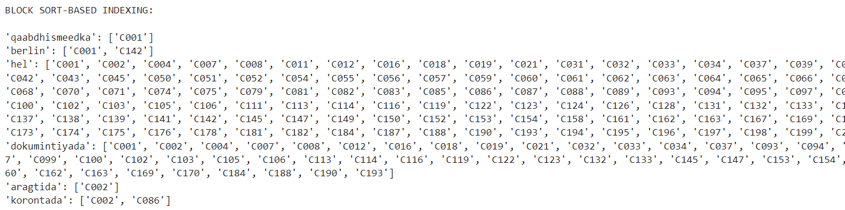
Block sort-based Indexing
It groups queries into blocks, tokenizes the text from titles and descriptions, and constructs an inverted index that maps each token to the corresponding query IDs. Finally, it prints the resulting sorted inverted index.

Slide 13
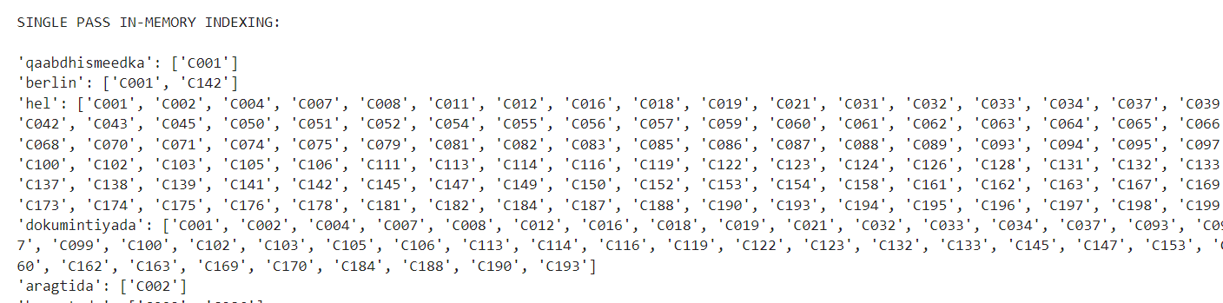
Single pass in memory indexing
Single-pass in-memory indexing method that reads queries from a text file and constructs an inverted index. The `single_pass_in_memory_indexing` function processes each query by extracting the query ID, title, and description, tokenizing the text, and mapping each token to its corresponding query ID in the inverted index. Finally, it prints the resulting inverted index.

Slide 14

Comparison between BSBI AND SPIMI
Compares the performance of two indexing methods—Block Sort-based Indexing and Single Pass In-Memory Indexing. It measures the time taken for each method to create an inverted index from the same set of queries, allowing for a performance comparison.

Slide 15
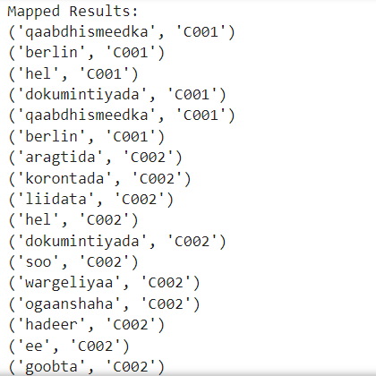
Map
Generates a list of tuples where each token is mapped to the corresponding query ID.

Slide 16
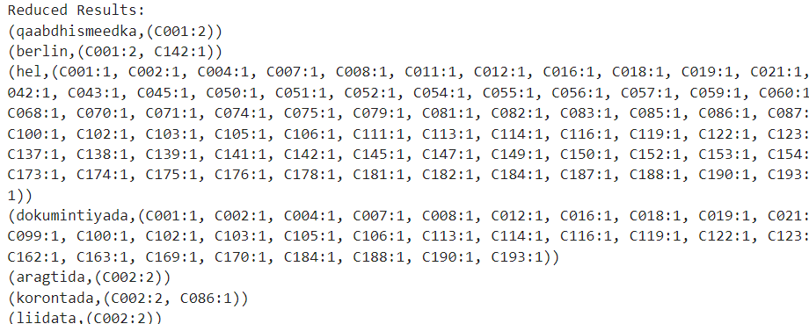
Reduce
Performs a reduce operation on the mapped results, counting how many times each term appears for each query ID.

Slide 17
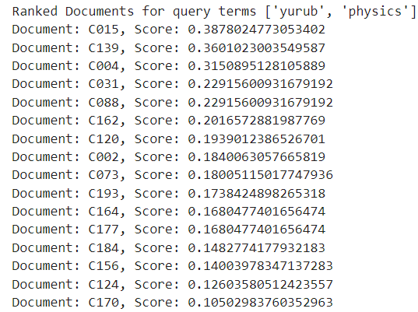
Implementation of TF-IDF Ranking
Computes TF-IDF scores for each term in each query. It then ranks the documents based on their cumulative TF-IDF scores for a given set of query terms, demonstrating the process of ranking documents using the TF-IDF model.

Slide 18
Challenges
Translation Ambiguity: Words can have multiple meanings, and choosing the correct translation for a query is challenging.
Resource Scarcity: For low-resource languages, translation tools or dictionaries may be unavailable or incomplete, making it difficult to perform effective CLIR.
Cross-Language Synonyms: A concept in one language might not have a direct equivalent in another language, complicating retrieval.

Slide 19
THANK YOU

